Slide 1
QUICK BASKET – A SMART SOLUTION
SSN COLLEGE OF ENGINEERING, Chennai (Affl. Anna University)
Adeeb Tahir
Adithya R Ganesh
Under the guidance of
Ms. Sasirekha

Slide 2
Problem Statement
To move the billing system to the basket.
Standing in queues takes time
Regions where population is high
A solution in festive periods
Increase profits in stores
Update the method of a conventional billing system

Slide 3
Current smart stores
Amazon Go store [1]:
Issues:
Not yet functioning in India
Cannot be implemented in any common hypermarket
1. https://www.amazon.com

Slide 4
Overview
LCD display to RF sensor connection
RF data transfer through Nodemcu
Save the product data in cloud
Suggest related products from processed amazon metadata of 1million products[2]
[2] R. He, J. McAuley. Modeling the visual evolution of fashion trends with one-class collaborative filtering.
WWW, 2016 J. McAuley, C. Targett, J. Shi, A. van den Hengel. Image-based recommendations on styles and substitutes. SIGIR, 2015

Slide 6
Assumptions
We assume that every individual has a smartphone
Individuals don’t add multiple items at the same time

Slide 7
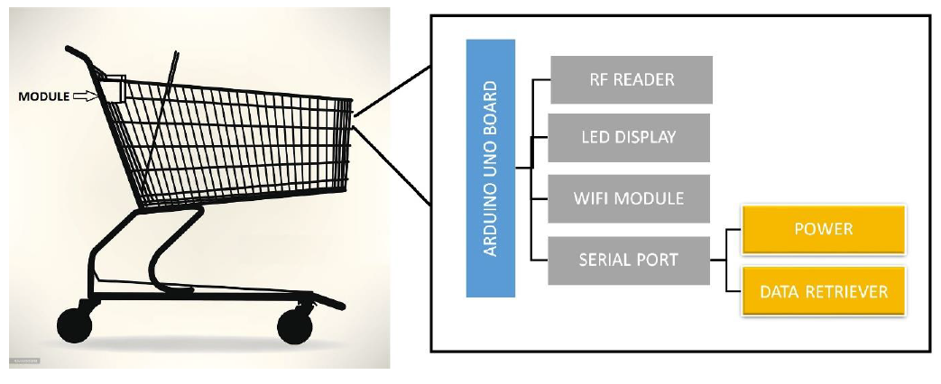
High Level model

Slide 8
System flow diagram
Fetched data displayed on webpage
Card ID sent to server to fetch data
Price details displayed on the LCD display
Other related products fetched by meta data pre-processing displayed
Final total bill
User taps RFID card on the sensor

Slide 9
Fetched data displayed on webpage
Card ID sent to server to fetch data
Price details displayed on the LCD display
Other related products fetched by meta data pre-processing displayed
Final total bill
User taps RFID card on the sensor

Slide 10
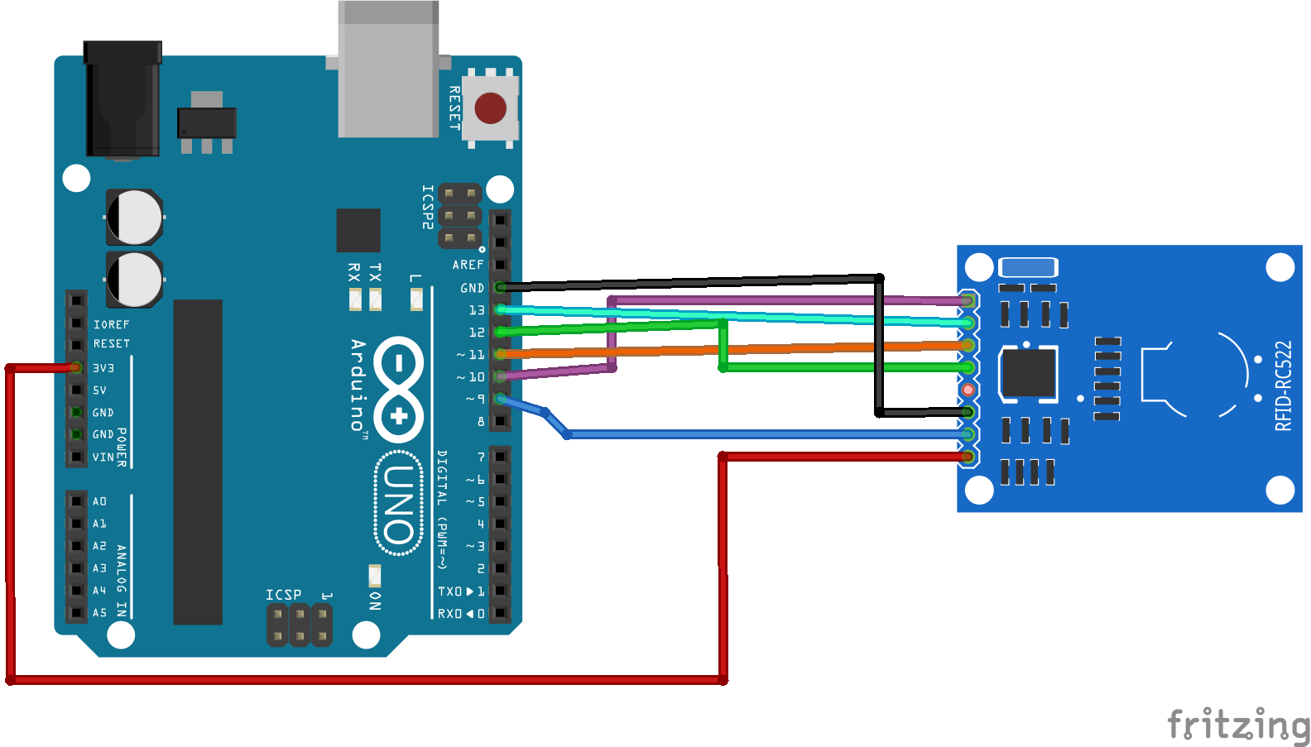
Working of RF reader
Each item contains an RFID tag. This tag is read by the RFID sensor and is sent to the Arduino.
Each item contains an RFID tag. This tag is read by the RFID sensor and is sent to the Arduino.

Slide 11
Fetched data displayed on webpage
Card ID sent to server to fetch data
Price details displayed on the LCD display
Other related products fetched by meta data pre-processing displayed
Final total bill
User taps RFID card on the sensor

Slide 12
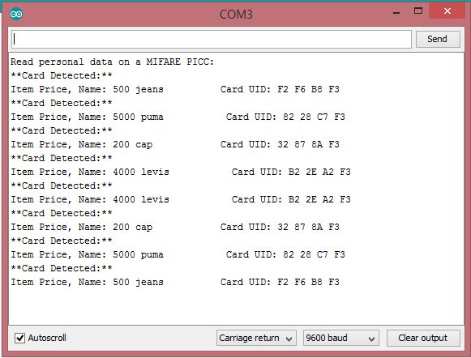



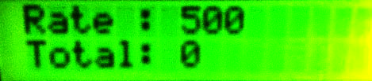
Sending data from Arduino to LCD display
Sample data in serial monitor which is displayed in the LCD
Item rate and total displayed on the LCD in the basket

Slide 13
Fetched data displayed on webpage
Card ID sent to server to fetch data
Price details displayed on the LCD display
Other related products fetched by meta data pre-processing displayed
Final total bill
User taps RFID card on the sensor

Slide 14
UID string sent via server to database

Slide 16
Fetched data displayed on webpage
Card ID sent to server to fetch data
Price details displayed on the LCD display
Other related products fetched by meta data pre-processing displayed
Final total bill
User taps RFID card on the sensor

Slide 17
Sample webpage displayed to the user

Slide 18
Fetched data displayed on webpage
Card ID sent to server to fetch data
Price details displayed on the LCD display
Other related products fetched by meta data pre-processing displayed
Final total bill
User taps RFID card on the sensor

Slide 20
Results
A better approach to buy products offline has been implemented that help both the general public and shops.
A Quick Basket module with price update functionality created. The module can successfully detect an item when placed in the cart and immediately flashes the updated price inclusive of the rate of the item on the LCD display. When the same item is scanned again, the price is subtracted indicating that the item has been taken out of the basket.
The integration of web page data feed synchronized with the Wi-Fi module allows for easy visualisation of what a customer has and helps in managing their constraints such

Slide 21
Conclusions and Future works
With further advancement in technology and scanning proficiency, this project could be extended to a more localised type of market like a grocery store where small items can also be embedded with RF tech.
Add simpler approach where the user needs to scan a QR code of the basket to start shopping

Slide 22
References
[1] Amazon Go store: www.amazon.com

